Slide 1
TTF Infrastructure & Operations Subcommittee
Organization Chart Recommendations
May 16, 2012

Slide 2
Org Chart Recommendation Overview
Goal: Sustain levels of service AND assure savings at the same time
We recommend three organizations
Engineering
DPW
Recreation Maintenance
Recreation Maintenance should stay within Recreation with no decrease in headcount

Slide 3
Expected Headcount Savings after Departmental Consolidation
 | May 2012 Combined Headcount | Consolidation Commission Report Recommendation (Based on 2010 Headcount) | TTF I&O Recommendation*
Engineering | 35.8 FTEs | 32.8 FTEs | 30.8 FTEs
Department of Public Works | 73 FTEs | 76 FTEs | 70 FTEs
* Recommendation for 2013. As per org charts, one additional management position will be phased out during 2013 and two more may be phased out.

Slide 4
Titles/Positions to Be Eliminated Under Consolidated Org Chart
 | TTF I&O Recommendation*
Engineering | Construction Inspector Zoning Officer Administrative Secretary (Zoning) Administrative Assistant Electric Subcode Official
Department of Public Works | Equipment Operator Equipment Operator Maintenance Person II
* Recommendation for 2013. As per org charts, one additional management position will be phased out during 2013 and two more may be phased out.

Slide 5
Expected Cost Savings from Consolidated Org Chart*
 | Consolidation Commission Report Recommendation | TTF I&O Recommendation
Engineering | $ 381,077 | $ 545,283
Department of Public Works | $ 103,000 | $ 183,369
Recreation Maintenance | $ 0 | $ 0
* Note: these numbers (1) have not yet been reviewed by the TTF Finance Committee and (2) do not include positions discussed in footnotes on previous slides

Slide 6
Proposed Engineering Org Chart

Slide 7
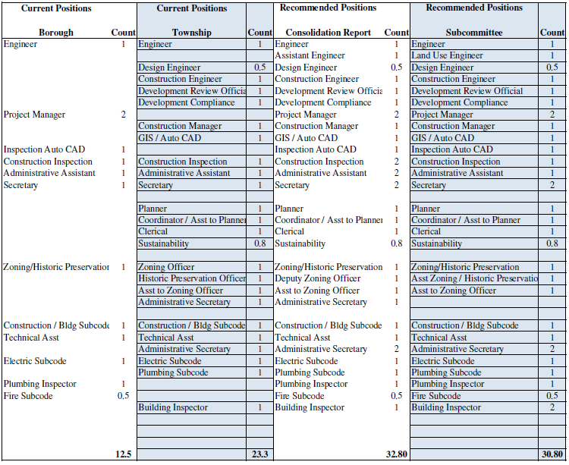
Proposed Engineering Headcount

Slide 8
Proposed Dept. of Public Works Org Chart

Slide 9
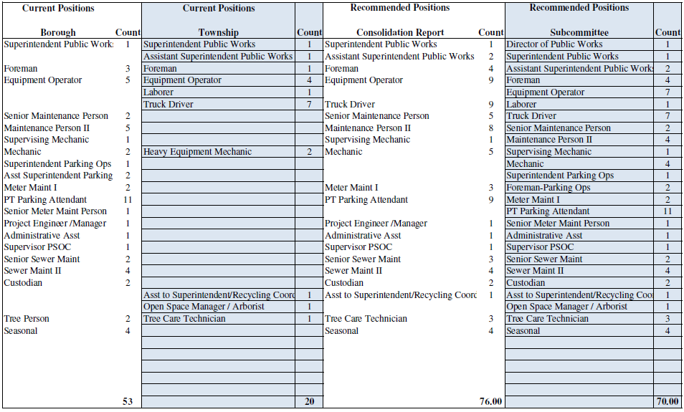
Proposed Dept. of Public Works Headcount

Slide 10
Other Comments
Thanks to John Heilner, Jo Butler, John Clearwater, Mark Freda, Kathy Monzo and Bob Bruschi
We informally recommend that the new governing body give serious thought to creating a Parks & Recreation Department
Coming attractions from the I&O Subcommittee:
DPW Facilities and Capital Equipment
Leaf/Brush Removal
Garbage/Composting Collection

