Slide 1
Princeton WWS Consolidation Review
Summary and Recommendations
December 19, 2012

Slide 2
Presentation Outline
Scope of Evaluation
Background on the Princeton Case
Recommendations
Notes:
Scope of Evaluation
-introduction of my team
-description of our research methods
-a discussion of our overal approach, the lens through which we viewed things
Background on the Princeton Case
Recommendations

Slide 3
Goals for this Evening
Review the work of the transition process from our perspective
Discuss the learnings and recommendations
Answer questions about our observations

Slide 4
Scope of evaluation

Slide 5
Woodrow Wilson School Team
Four Masters in Public Affairs students, one undergraduate
Laura Blumenthal, Monica Chon, Logan Clark, Kim Harris, Daniel Sanchez
Each student followed the activities of one Transition Task Force subcommittee that community and municipal leaders agreed was most critical
Facilities and Other Assets
Finance
Infrastructure and Operations
Personnel
Public Safety
Notes:
I am a native of Princeton, lived here until I was 14, had a specific interest in seeing the consolidation succeed

Slide 6
The Research Methodology
Attendance at meetings
Document reviews
Personal interviews
Anonymous web-based survey
Literature reviews
Team meetings
Notes:
Employed a multi-method approach
-ordered from primary to secondary sources
-reviews of both the minutes of meetings we couldn’t attend, and outcome documents such as personal selection criteria
emphasize methodology, triangulation from many different sources

Slide 7
WHAT DO WE ADD?
CGR
Documentation of key events
Woodrow Wilson School Graduate Consulting
Subjective analysis of the transition process
Attempts to distill generalizable lessons from the Princeton experience
Intended audience outside of Princeton
Notes:
Study intended for other communities considering consolidation as well as state officials at DCA who will work with communities

Slide 8
Note on Tone of Evaluation
Notes:
Faced several obstacles→ students doing this all pro-bono, not for credit, time spent on this task often competed with that spent on not only (1) coursework, but (2) job hunting, and (3) performing internships in various other parts of the world
Time limitations, couldn’t document everything, and list out all the fantastic things that the TTF did well, we had to pick a lens through which to view events,
Our scope of work, from the outset, was to draw from this process the key lessons learned, consequently we had to look at things with a critical eye
It was an exercise in constructive criticism, I emphasize the constructive part!
I think I speak for whole group when I say that we were all thoroughly impressed with your hard work and dedication.
When other communities are looking at this they don’t want to think that it was all a slog, but that it was a great success

Slide 9
Background

Slide 10
Historical Context
Fourth consolidation attempt succeeded after failing in 1953, 1979, and 1996
What made this time different? – Many factors -- Including:
2008 Financial Crisis and projected consolidation savings
2007 Adoption of Local Option Municipal Consolidation Act
The Involvement of Governing Officials
Support of a Experienced Consultant
Notes:
This report covers only those events from the vote approving consolidation up to the date of consolidation, but to put events in context its worth considering the history behind this
Would be interested in getting opinion on how the Financial Crisis impacted NJ municipalities
Key provisions of 2007 Consolidation Law
-Loosened timelines
-Eliminated need for an elected study commission or voter referendum to initiate feasibility study
Consolidation Study Commission estimated state would save $3.1 annually after 3 yrs., while incurring one-time transition cost of $1.7M

Slide 11
Consolidation Leadership
Transition Task Force
Transition Task Force Subcommittees
Governing Body
Municipal Administrators
NJ Dept. of Community Affairs (DCA)
Notes:
THANK EVERYONE!!!
Governing Body
Because the authority of the TTF was limited, all of its policy recommendations were referred to the joint governing body, which ultimately voted on whether to make them binding. Many of these elected officials were active supporters of consolidation.

Slide 12
The Recommendations
Notes:
NJ law provided guidance on CSC efforts but little direction on consolidation implementation

Slide 13
No. 1 Structure and Sequence
The Princeton Experience
Alternatives
Appoint a volunteer Transition Task Force but postpone TTF deliberations.
Require members of the Consolidation Study Commission to implement consolidation.
Delegate all consolidation implementation-related activities to municipal administrators and their staff.
Hybrid option
Create a TTF composed primarily of willing members of CSC, but also Governing Body members and Administrators from each municipality
Give votes, give proper deference to professional Administrators
Notes:
Despite the fact that the TTF was created on the fly out of a body of volunteers, people learned quickly and it did not derail the whole process
Option 1 would reduce political posturing, BUT
-decisions would have to be made overnight
-diminished incentives for talented leaders to volunteer
-no opportunity for aspiring political candidates to educate themselves
→ Instead address fillibustering tendencies up-front, impose limits on rehashing already-resolved debates
Option #2
Given the fact that there is no statutory guidance as to how subsequent bodies are bound by CSC recommendations
Would retain most institutional knowledge and minimize confusion over jurisdiction and accoutability between subsequent transition authorities
-constraints on members’ time and experience (may get more experienced people to in separate process of recruitment for transition authority
Option 3
Administrators most knowledgeable about details for transition matters, can avoid discussions of irrelevant contingencies

Slide 14
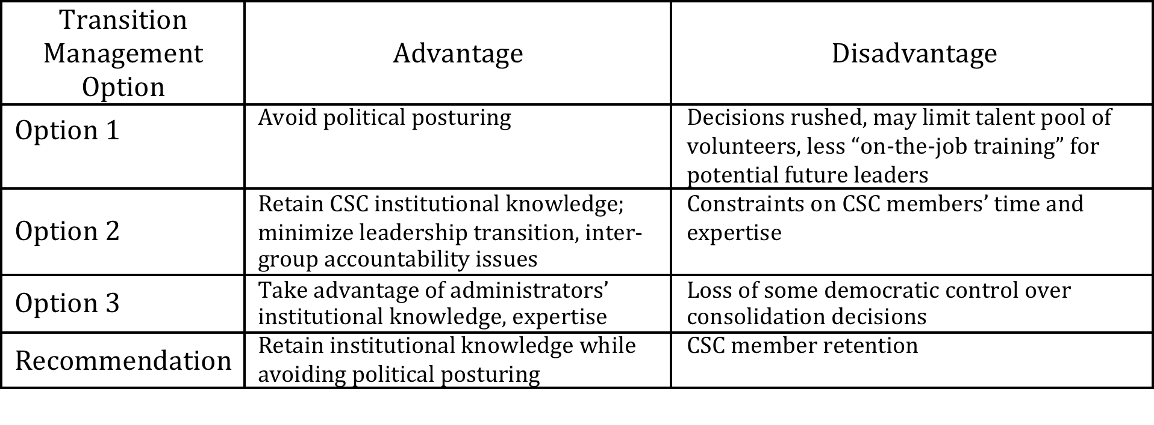
Pros and Cons of each

Slide 15
No. 2 Defining Transition SOW
No precedent for Transition Task Force Resolution
Uncertainty regarding SOW Depth
“Do no harm” approach (respecting CSC precedent) vs. desire to seize the opportunity for systemic reform
How deep in the weeds to explore
Uncertainty regarding SOW Breadth
Jurisdictional boundaries
Empowering the work of others
Notes:
Benefits harmonization
Organization chart reorganization
Rules for eligibility for redundant positions
This is the first one to be developed, all things considered it was pretty good
Although there were some instances where mistrust was created, in retrospect members did not harbor an ill will, have forgotten all feelings of antipathy
Jurisdictional Boundaries
-Personnel and Public Safety subcommittees overlap on police personnel separation options
--created sense of mistrust, feeling of being left out

Slide 16
No. 2 (contd.) Recommendation
Resolution establishing the Transition Task Force should ensure transition team is absolutely clear on the parameters of its authority.
The degree to which TTF leaders will be permitted to explore systemic reforms and/or other efficiency gains
Whether or not they can weigh in on managerial decisions normally determined by professional staff.
Clearly set jurisdictional boundaries
Communicate progress across subcommittees
Notes:
Part of the jurisdictional boundary issue was the fact that everyone on the TTF was briefed on every issue regardless of where they sat on the subcommittee

Slide 17
No. 3 Money Matters
Anticipate challenges in harmonizing budgets
Seek prior clarity from state on cost reimbursement eligibility
Defining what is directly transition related
Notes:
The work of TTF and subcommittee had a touch task, but really did a stellar job
But the TTF actually did a really good job of getting there

Slide 18
No. 4 Transparency Concerns
Confusion over disclosure requirements
Full committee subject to OPMA guidelines
Subcommittees exempted
Should emails and other communication be outside public domain?
Recommendations
Outline public meeting policy prior to the deliberations
TTF issue clear directive
Hold debriefings after closed meetings
Inform public of their right to information, and facilitate access through web or social media
Notes:
The transparency issues were eventually worked out, in the process there was a lot of turmoil, but they worked it out!
It took a while for them to get clear on whether the OPMA guidelines applied

Slide 19
No. 5 Communication
Understand the conflicting interests at play, resulting status-quo bias
Service vs. costs
Take measures to ensure balanced representation of interests
Engage consolidation’s beneficiary groups
Quell false rumors by avoiding their repetition and providing contrary correct information
Avoid overemphasizing losses, which have the tendency to loom larger than gains
Elevate rhetoric to consolidation’s overarching goals
Notes:
Over a period of time, the results were indeed balanced and the tyranny of the organized was diminished
Elevate rhetoric to overarching goals, rather than letting initiatives die under their own weight
The tyranny of the organized

Slide 20
No. 6 Service Levels vs. Savings
Anticipate tendency to err on the side of service-level maintenance over cost-savings
Outside consultant useful in implementing unpopular reforms or resolving competing agendas
Deflect attention from zero-sum issues toward measures bringing about efficiencies of scale
I&O task force did a great job with this
Notes:
Brush and Leaf Collection
Expanding the reporting burden to managers
Police Staffing
Facilities Relocation
In sum, the process of reconciling differences in service levels and payment methods across the consolidated municipality may result in unanticipated costs. This may render the twin promises of consolidation—achieving cost savings while maintaining service levels—difficult to accomplish. Where there is a substantial disparity in the level of service (and its associated cost) between the consolidating municipalities, as in the case of brush and leaf collection and policing services, achieving one of these objectives may come at the expense of the other.

Slide 21
Applications to Other Municipalities
Princeton’s unique resources
Initiative of municipal leadership
Differential benefits in terms of cost-savings
Princeton already had many consolidated or shared services
Low-hanging fruit may have already been picked
Other communities may have greater opportunity for cost-savings
Notes:
Municipal leadership Initially took the proposal to the state

Slide 22
Closing Remarks
Notes:
In 1835, Alexis de Tocqueville remarked that the success of American democracy could be attributed to the vibrancy of its civic life.
I myself, as someone who studies institutional development in lesser-developed countries, considered this case a real tour-de-force of civic participation and municipal governance.
Princeton residents came together on their own initiative, consulted with each other and cooperated toward toward a bipartisan solution to a problem for which there was no precedent.
Given the current national-level political climate, this is nothing short of remarkable.

