Slide 1
Creating One Batavia
Merging the Town and City into one City of Batavia
Presented by
Consolidated Charter Task Force of Batavia

Slide 2
Background
Community has discussed shared services & consolidation for many years
2008-09 consolidation study suggested that one city could save residents nearly $900,000 in combined costs
Leaders in both communities decided to put the issue to voters
Task Force was formed by the Town and City to generate a new city charter to be voted on by residents in both municipalities
City and Town jointly received a Local Government Efficiency Grant to underwrite the cost of the process

Slide 3
8-Member Task Force
Town
City
Judith Cotton
Larry Reisdorf
Marcia Riley
Chad Zambito (Chair)
Alan Koch (Alternate)
Gail Stevens
Laura Landers
Chad Bachorski
Joe Gerace

Slide 4
Charge of Task Force
Develop a new city charter
Develop the home rule message
Develop the authorizing legislation
Establish a formal timeline
GOAL: Referendum on a new city charter in November.

Slide 5
What the Task Force can and cannot address?
The Task Force can:
Propose the form of government
Develop the structure for tiered (zone) services/taxes
Decide on wards vs. at-large voting
Develop the framework for what services will be provided
The Task Force cannot:
Rework fiscal impact projections
Address transitional issues and negotiate agreements
Determine final service levels and service quality

Slide 6
Overview of Process
TF began meeting in October and started to review the CGR study. TF then received overview from CGR & received input from Town and City officials.
TF then drafted an RFP to select a consultant. Factors considered included: Familiarity w/study & region, Experience in similar efforts, availability of staff & cost.
TF selected CGR and began tackling key issues: Form of Government, At-Large vs. Ward and Taxing Tiers.
TF expected to complete the charter and then request home rule legislation to make the referendum possible – State Representatives recently requested a resolution be passed by both boards to begin the home rule process.

Slide 8
New City Charter: Form of Government
First issue tackled by TF was the form of government
Weak Mayor-Council Form
Strong Mayor-Council Form
Standard Mayor-Council Form
Chief Administrative Officer (CAO) Model
Council-Manager Form
Commission Form

Slide 9
Decision
Commission and CAO models both dismissed.
Mayor models dismissed because they could encourage patronage and failed to guarantee a skilled and trained professional be selected to oversee day to day operations of the city.
Council-Manager Form Chosen because it provides:
Administrative expertise
Clear lines of authority and accountability
Professional standards that tend to trump partisan/parochial concerns
Promotion of cooperation and partnerships rather than conflict.
*Form of Government Primer Provided by CGR www.cgr.org/onebataviacharter/documents.aspx

Slide 10
New City Charter: Council Representation
At Large System
Ward System
Mixed Elections
Single Transfer System
Cumulative Voting

Slide 11
Decision
Single Transfer Voting and Cumulative Voting dismissed
At Large and Ward dismissed
Mixed System chosen:
Combines city-wide focus of at large members with neighborhood and local concern represented by the ward-elected members.
Used by 38% of large cities and 17% of small-medium cities.
New Structure Consists of 4 ward and 5 at large seats.
*Primer on Council Representation Provided by CGR www.cgr.org/onebataviacharter/documents.aspx

Slide 12
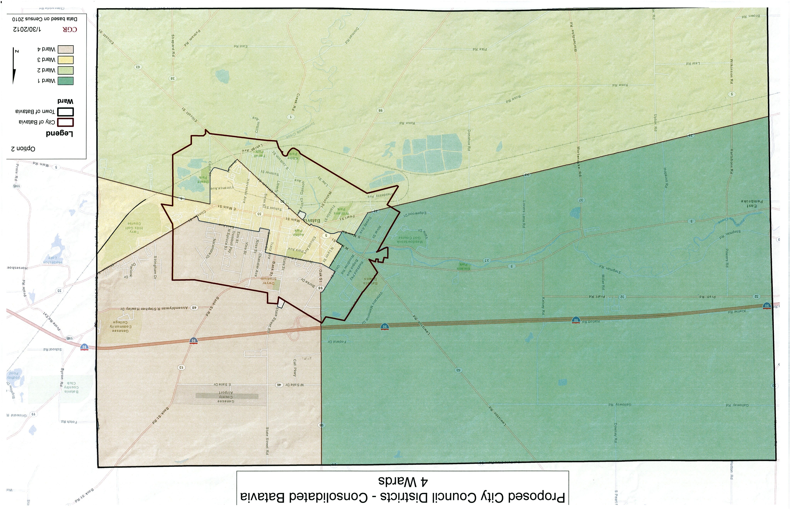

Slide 13
New City Charter: Tiered Taxing
The TF believes it is essential that current Town residents continue to enjoy the zero tax rate and not be burdened with current city debt or be required to pay for services currently provided by the city.
The only way to accomplish this is through a tiered taxing structure.
There would be three tiers:
The Current City
The Current Town
The Entire New Entity
This configuration is guaranteed by the charter which requires a referendum to extend the inner taxing jurisdiction and/or services.

Slide 14
Timeline
May 15: Next Task Force Meeting
May 17: Info Session in Town at Town Hall
May 24: Info Session at City Hall
May 31: Public Hearing
June 4: Public Hearing
June 11: Public Hearing
June 21: Public Hearing

Slide 15
Timeline
July: Public input reviewed, documented, edits, corrections made to proposed charter.
August: Revised charter introduced to City and Town officials
City and Town Boards then hold their own public hearings
City and Town Boards then vote on final charter & ballot initiative
September: Ballot submission by both Town & City Clerks required by 9/6
November 6th Election Day

Slide 16
If Approved
Town and City Boards, appointees and employees remain in place until January 1, 2014.
The current TF recommends that a Consolidation Committee be formed composed of elected officials and residents of both entities.
The TF is compiling a list of recommendations for transition.
Election to fill the new City Council take place in November of 2013 with at large seats serving a 4 year term and ward seats filling an initial 2 year term to stagger elections.
All terms will be four year by 2016.

Slide 17
Ways to Engage
Previous Study: www.cgr.org/bataviaconsolidationplan
Current Study: www.cgr.com/onebataviacharter
Email TF: http://www.cgr.org/onebataviacharter/email.aspx

